Slide 1
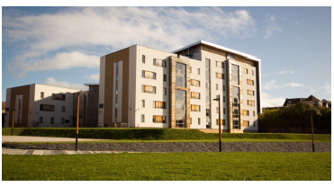

Fire Safety City Campus
This presentation will help you understand the fire safety procedures we have in place at the University. We hope you have an enjoyable and safe stay.

Slide 2
Important things to know
Fire alarms at the University are designed to a very high standard.
Every bedroom and kitchen has a fire alarm detector and sounder.
If the alarm sounds, it will let our security team know and they will respond.
Fire doors prevent the spread of fire and must not be held open.
The fire alarm will always sound in the whole building
If you hear the alarm you must evacuate! Please stay calm.

Slide 3
On Hearing the Fire Alarm
Step 1 Evacuate (leave) the building immediately via your nearest fire exit. Please look for the signs provided.
Step 2 Walk straight to your fire assembly point – see the map provided for your nearest assembly point.
IMPORTANT !
If you notice someone is missing, is in danger, or requires assistance, please inform one of your teachers or a member of University staff – who will be wearing a hi-visibility jacket.
Step 3 Stay at the Assembly point until the ‘all clear’ is given to return to your to your room.

Slide 4
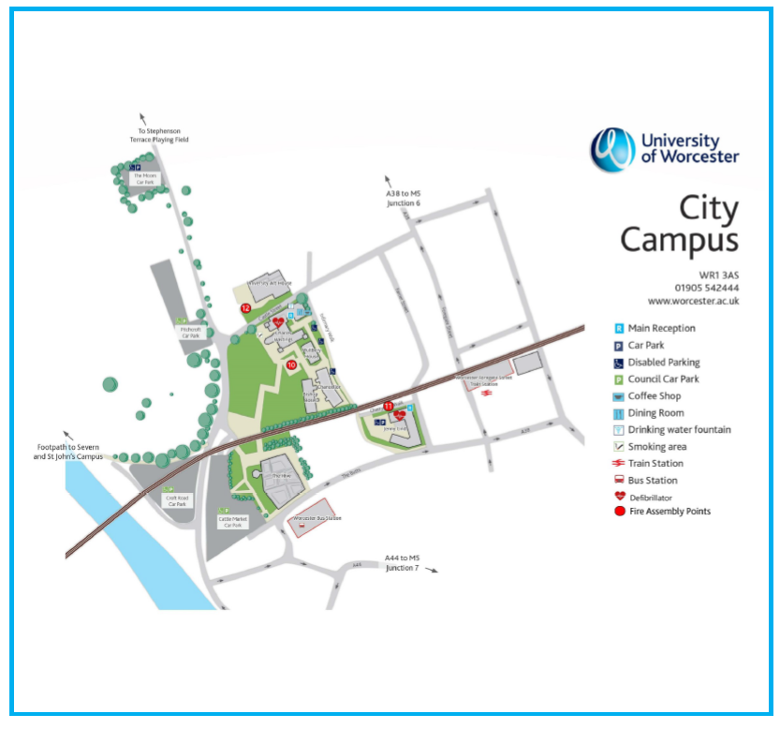
Assembly Points
City Campus Fire Assembly Point
The assembly points have been circled in red for your attention.
Bishop Bosel and Chancellor Halls of residence is point 10
Charles Hastings Building is point 10

Slide 5
If you discover a Fire
Step 1 Sound the nearest fire alarm by breaking the glass. Fire alarms are located by fire exits and stairwells.
Step 2 Evacuate the building by your nearest available exit.
Step 3 Report to your assembly point

Slide 6
For your own safety it is import that you DO NOT do the following
DO NOT take any risks
DO NOT try to fight the fire
DO NOT stop to collect personal belongings
DO NOT return to the building until authorised to do so.
DO NOT use lifts unless authorised to do so
DO NOT wedge/prop doors open.

Slide 7
When arriving on campus it is important to DO the following
KNOW where your nearest fire is Located
DO familiarise yourself with the fire assembly points (particularly the one closest to you)
KNOW where your nearest fire alarm point is
DO treat every fire alarm as an emergency

Slide 8
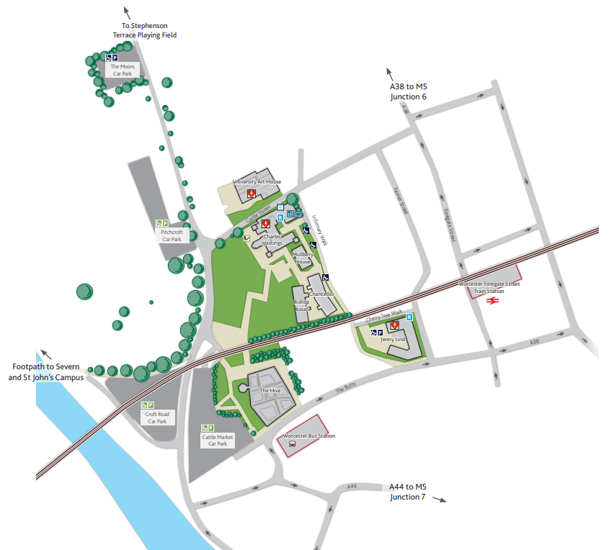
Smoking
If you wish to smoke on campus please only smoke in the designated areas on City Campus.
The smoking area has been circled in yellow on the map and is located behind the Charles Hastings Building
City Campus Smoking Area

Slide 9
First Aid
If yourself or anyone around you requires first aid, please call our 24hr main reception on 01905 855000. They will be able to send a fully qualified first aider over to you as soon as possible.
If it is obvious that the accident requires urgent medical attention please contact the Ambulance Service first, by calling 999, and then notify Security/Main Reception.
If you are calling from a mobile phone registered outside the UK, the numbers are;
Reception +44 1905 855000

Slide 10
Security / Safety
We have a Security Team on Campus 24/7. If you require any assistance from them at any time please contact main reception on 01905 855 000 and ask to speak to security. If you prefer to speak to them face-to-face, you will be able to find them at Reception in the Charles Hastings Building
You can also contact security on their 24/7 mobile number which is 07977973956
If you are using a mobile telephone registered outside the UK please dial the following numbers;
Security Mobile +44 7977 973956

